Slide 1
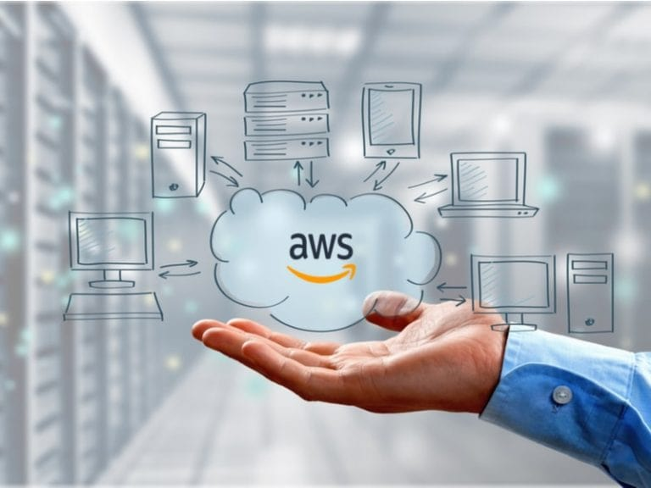
AWS Cloud Practitioner
Moinak Pyne
March 2022

Slide 2
Contents
Introduction to AWS
Compute in the Cloud:
EC2, Pricing, Scaling, Load Balancing, Additional Services
Global Infra and Reliability:
Regions, AZ, Edge
Networking:
Connectivity, Subnets and NACLs, Global Networking
Storage and Databases:
EBS, S3, EFS, RDS, DynamoDB, Redshift, DMS, Additional Services

Slide 3
Contents 2.0
Security:
Shared Responsibility, User Permissions and Access, AWS Org, DoS
Monitoring and Analytics:
CloudWatch, CloudTrail, Trusted Advisor
Billing:
Pricing Concepts, Billing db, Consolidated Billing, Budgets, Cost Explorer, Support Plans, Marketplace
Innovation:
Serverless, AI, ML
Migration:
CAF, Migration Strategies, Snow Family

Slide 4




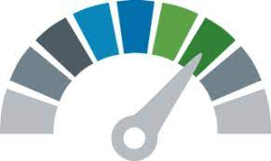
Introduction to AWS
Operational Excellence
Security
Reliability
Performance Efficiency
Cost
Optimization
Run, manage and monitor workloads with continuous improvement
Protecting assets and information with risk assessment and unplanned failures
Auto recover from infra or system failures while meeting operational thresholds
Using computing resources efficiently to support on-demand changes
Avoid unnecessary cost or replace with cost-effective solutions while meeting best practices and business needs

Slide 5
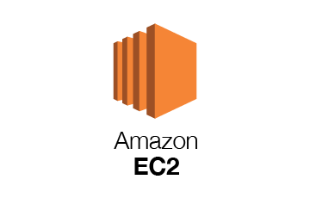


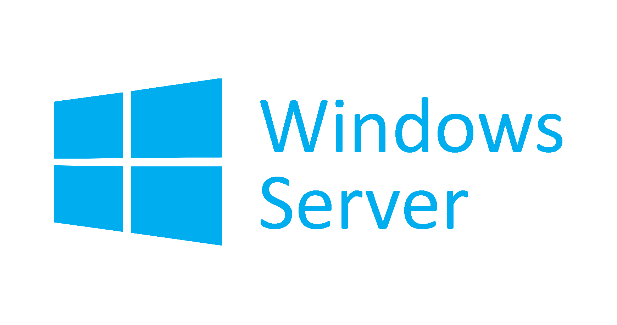

Compute in the Cloud
EC2 | Pricing | Scaling | Load Balancing | Additional Services
Elastic Cloud Compute (EC2) is a highly configurable virtual server.
EC2 is a resizable compute capacity. It takes minutes to launch new instances
Anything and everything on AWS uses EC2 instances underneath
Choose OS via AMI
t2.nano
$0.0065/hour ($4.75/month)
1 vCPU 0.5GB Mem
C4.8xlarge
$1.591/hour ($1161.43/month)
36 vCPU 60GB Mem 10 Gigabit performance
Choose Instance Type
Add Storage (EBS, EFS)
SSD HDD Multiple Volumes
Configure Instance
Security groups, Key Pairs, User-Data, IAM Roles, Placement Groups

Slide 6
Compute in the Cloud
EC2 | Pricing | Scaling | Load Balancing | Additional Services
Instance Families:
Are different combinations of CPU, Memory, Storage and Networking capacity.
General Purpose: balance of compute, memory and networking (web servers and code repos)
Compute Optimized: Ideal for applications that benefit from high performance processors (scientific modeling, dedicated gaming servers, ad engines)
Memory Optimized: workloads that process large data sets (real- time big data)
Accelerated Optimized: hardware accelerators and co-processors (ML, bitcoin mining, speech recognition)
Storage Optimized: high sequential read and write access (in-memory transactions)
Pricing: There are 5 different ways
Least Commitment
Biggest Savings
On-Demand
Low cost, pay per hour or second
Short-term, unpredictable workloads
Spot up to 90%
Request spare capacity
Can handle interruptions, non-critical tasks
Best Long-term
Most Expensive
Reserved up to 75%
Steady state or predictable usage
Commit to 1or 3 yr term
Can resell unused
Dedicated
Dedicated servers
When a guaranteed isolated server is needed
AWS Savings Plan is another way but can be used for more than EC2

Slide 7
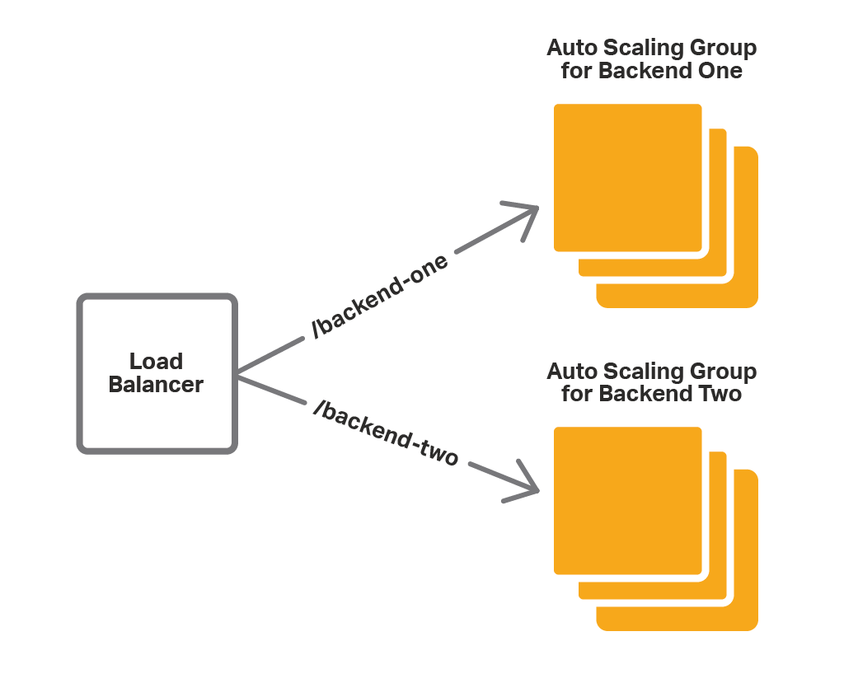
Compute in the Cloud
EC2 | Pricing | Scaling | Load Balancing | Additional Services
EC2 Auto Scaling helps in maintaining application availability and allows automatic addition/removal of EC2 instances according to defined conditions (min/desired/max)
Elastic Load Balancing (ELB) automatically distributes incoming application traffic across multiple targets and virtual appliances in one or more Availability Zones (AZs).
Can be used with Applications/ Gateway/ Network

Slide 8
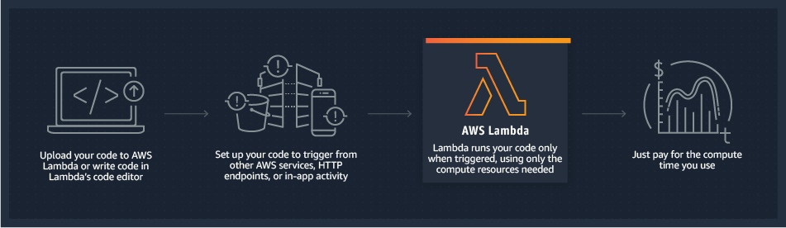
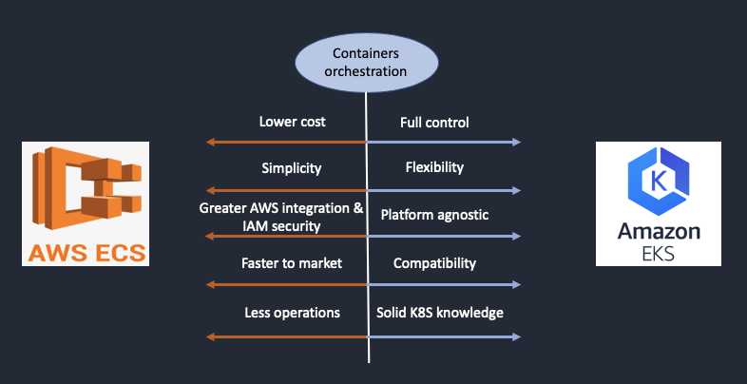
Compute in the Cloud
EC2 | Pricing | Scaling | Load Balancing | Additional Services
Lambda
A service which allows running of code without needing to provision or manage servers
Elastic Container Service is a highly scalable high-performance container management system that enables running and scaling of containerized applications
Elastic Kubernetes Service can be used to run Kubernetes on AWS
Fargate Is a serverless compute engine for containers. It manages the server infrastructure.

Slide 9
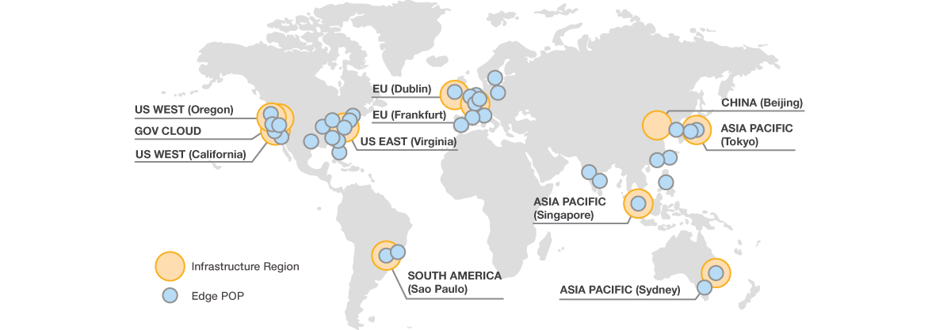
Global Infra and Reliability
Region | Availability Zones | Edge Locations

Slide 10
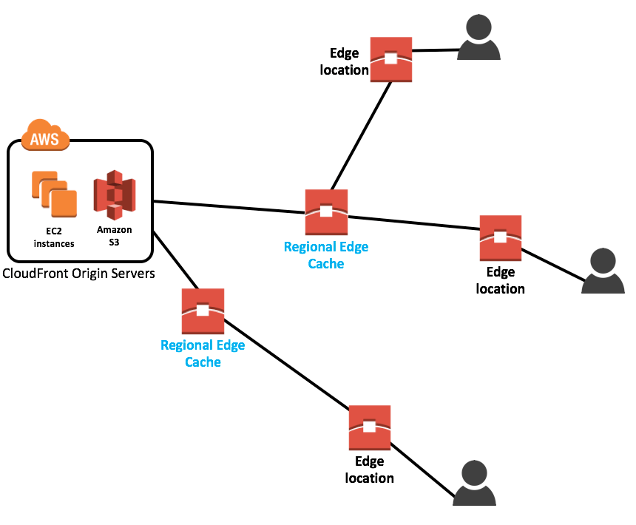
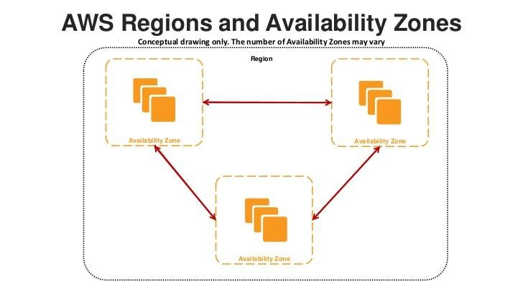
Global Infra and Reliability
Region | Availability Zones | Edge Locations
A Region is a physical location around the world where clusters of data centers are present.
An Availability Zone is one or more discrete data centers with redundant power, networking, and connectivity in an AWS Region.
Edge locations are data centers designed to deliver services with the lowest latency as possible. They’re closer to users than Regions and AZs.
Servers which use Edge are:
CloudFront, Route 53, AWS Shield.

Slide 11
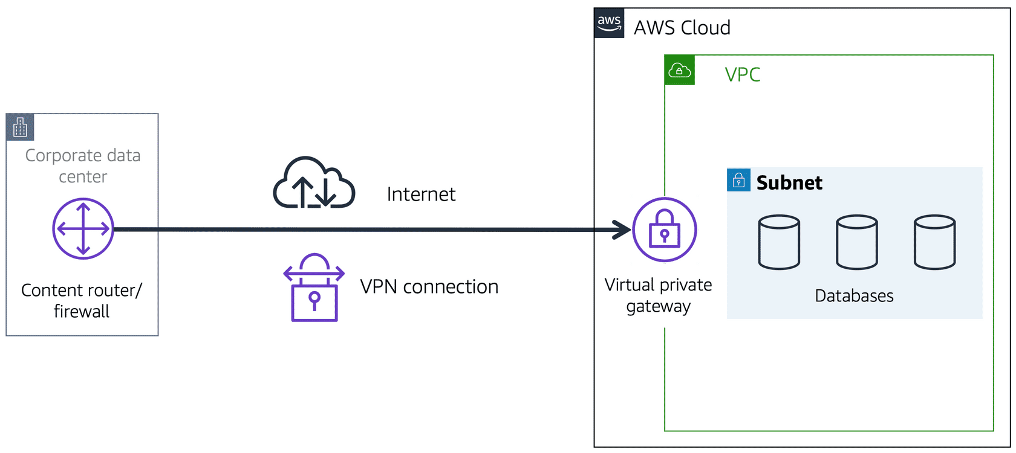
Networking
Connectivity | Subnets and NACLs | Global Networking
A Network Service that can establish boundaries around AWS Resources is called a Virtual Private Cloud
A subnet is a section of a VPC in which you can group resources based on security or operational needs.
A network access control list (ACL) is a virtual firewall that controls inbound and outbound traffic at the subnet level.
Accessing the VPC is done through an Internet Gateway and if accessing private resources then a Virtual Private Gateway is used

Slide 12
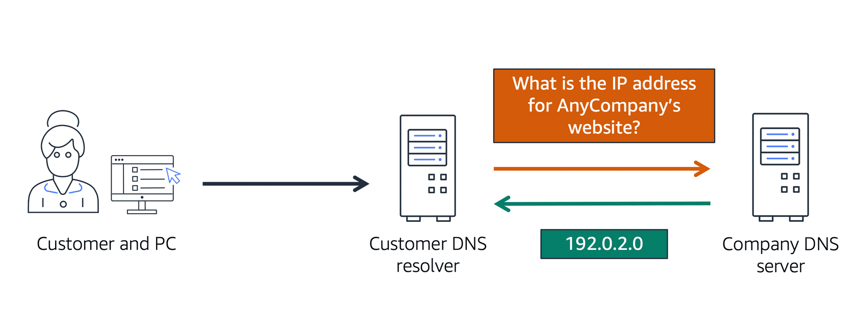
Networking
Connectivity | Subnets and NACLs | Global Networking

Slide 13



Storage and Databases
EBS | S3 | EFS | RDS | DynamoDB | Redshift | DMS | Additional Services
Elastic Block Storage (EBS)- Block
Data is split into evenly split blocks
Directly accessed by the OS
Supports only a single write volume
When you need a virtual hard drive attached to a VM
Elastic File Storage (EFS)- File
File is stored with data and metadata
Multiple connections via a network share
Supports multiple reads, writing locks the file
When you need a file-share where multiple users or VMs need to access the same drive
Amazon Simple Storage Service (S3)- Object
Object is stored with data, metadata and Unique ID
Scales with limited no file limit or storage limit
Supports multiple reads and writes (no locks)
When you just want to upload files, and not worry about underlying infra.

Slide 14
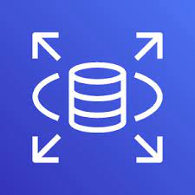

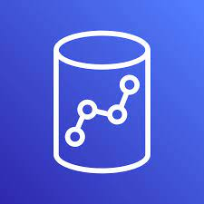
Storage and Databases
EBS | S3 | EFS | RDS | DynamoDB | Redshift | DMS | Additional Services
A database is a mode complex data store as it requires using formal design and modeling techniques (for semi-structured/ structured data)
Relational Database Service (RDS) is a relational database service that supports multiple SQL engines. Relational is synonymous with SQL and Online Transaction Processing (OLTP).
MySQL, MariaDB, Postgres (PSQL), Oracle, MSSQL, Aurora (5x faster than MySQL)
DynamoDB is a serverless NoSQL key/value and document database that is designed to scale to billions on records with guaranteed consistent data return.
Document DB is a NoSQL document database that is “MongoDB compatible”
Redshift is a petabyte-size data-warehouse. They can be expensive as they keep the data “hot”, meaning we can run complex queries on large datasets and get back the results very fast.

Slide 15
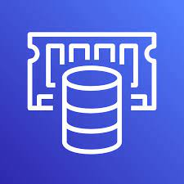
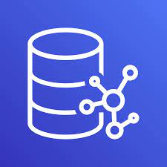
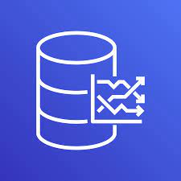
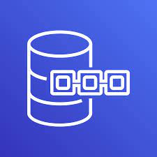
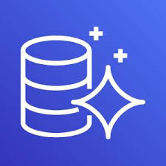
Storage and Databases
EBS | S3 | EFS | RDS | DynamoDB | Redshift | DMS | Additional Services
ElastiCache is a managed database for in-memory and caching. When you need to improve performance of applications by adding a caching layer in-front of web server or database.
Neptune is a managed graph database. Data is represented as interconnected nodes. (social media relationships)
Timestreams is a fully managed time series database. When you need to measure how things change over time
Quantum Ledger Database is a fully managed ledger database which provides transparent, immutable and cryptographically variable transaction logs
Database Migration Service (DMS) allows migration from:
On-premises data to AWS
From two databases in different or same AWS accounts using different SQL engines
From SQL to NoSQL DB

Slide 16


